Slide 1

Phishing Attacks Awareness

Slide 2
Our Phishing Awareness Agenda
Introduction to Phishing
Phishing Risks & Impact
Types of Phishing
Real-Life Examples
Attack Flow (Step-by-Step)
Identification Signs
User Do’s and Don’ts
Reporting Procedure
Best Practices
Live Demo
Key Takeaways
Q&A

Slide 3
Introduction to Phishing
Phishing is a cyber attack that tricks users into sharing sensitive information
Attackers pretend to be trusted sources (IT, Bank, Company, Email Provider)
Common targets: Passwords, OTPs, Financial data, Company information
Phishing attacks rely on human mistakes, not technical hacking

Slide 4
Phishing Risks & Impact
Account Compromise Stolen credentials allow attackers to take full control of email and systems
Data Breach Confidential company and client information can be exposed or leaked
Financial Loss Fraudulent transactions, ransom demands, and recovery costs
Identity Misuse Attackers send phishing emails using the victim’s identity
Business Disruption Locked accounts, system downtime, and operational delays
Reputation Damage Loss of trust from customers, partners, and stakeholders
Legal & Compliance Risk Possible regulatory violations and penalties

Slide 5
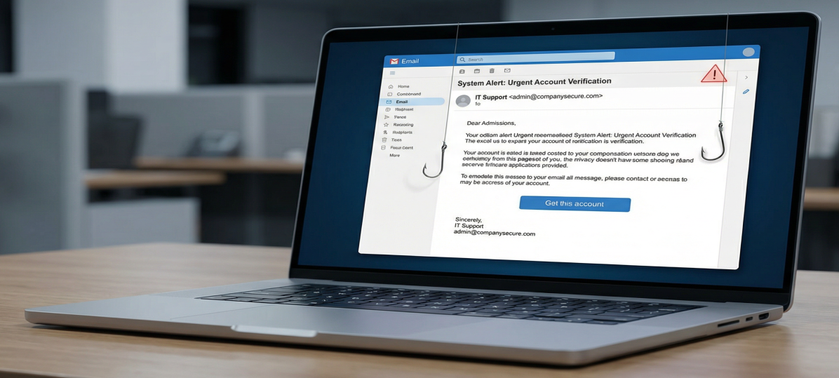
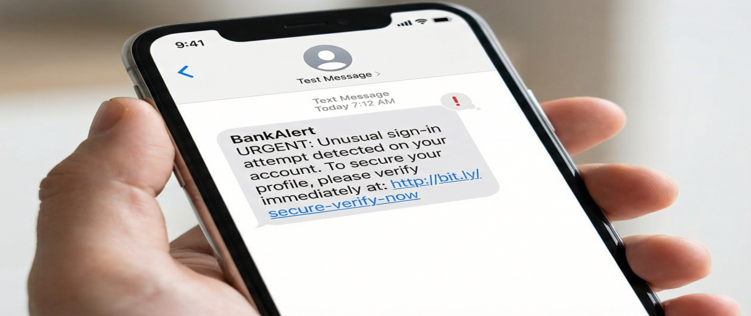
Types of Phishing
Email Phishing Fake emails pretending to be from trusted organizations
Smishing (SMS Phishing) Fraudulent text messages with malicious links

Slide 6

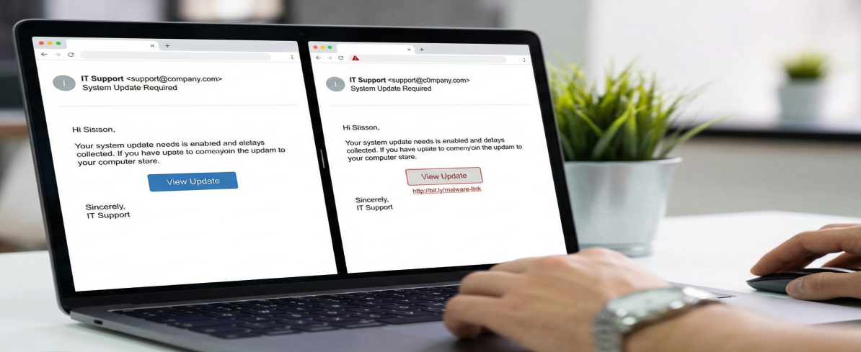
Types of Phishing
Vishing (Voice Phishing) Phone calls impersonating banks or IT support
Clone Phishing
Legitimate-looking emails copied and resent with malicious links

Slide 7
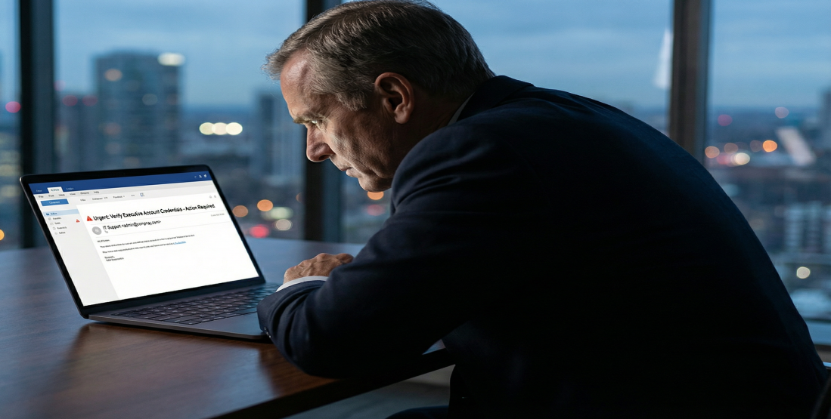
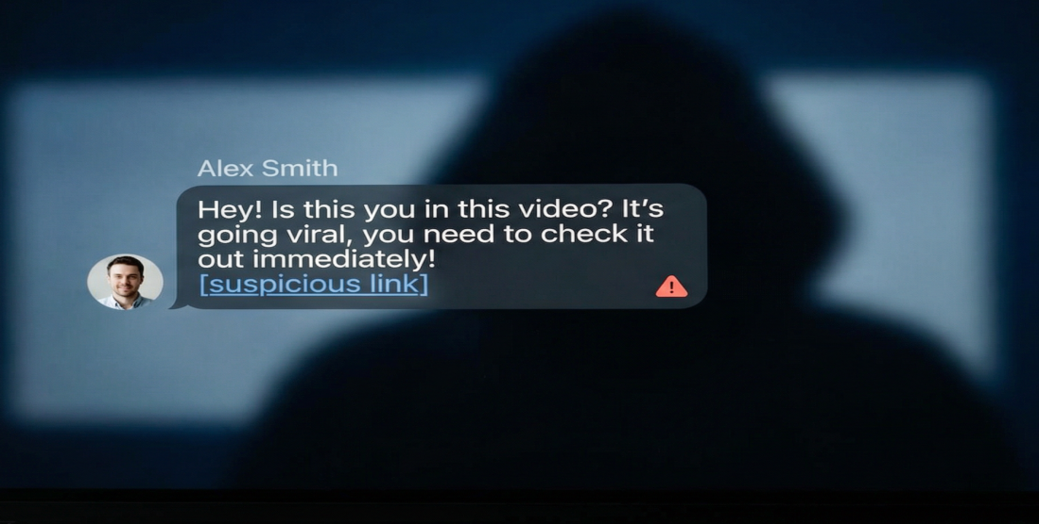
Types of Phishing
Whaling
Phishing attacks targeting senior management or executives
Social Media Phishing Fake messages and links sent through social platforms

Slide 8
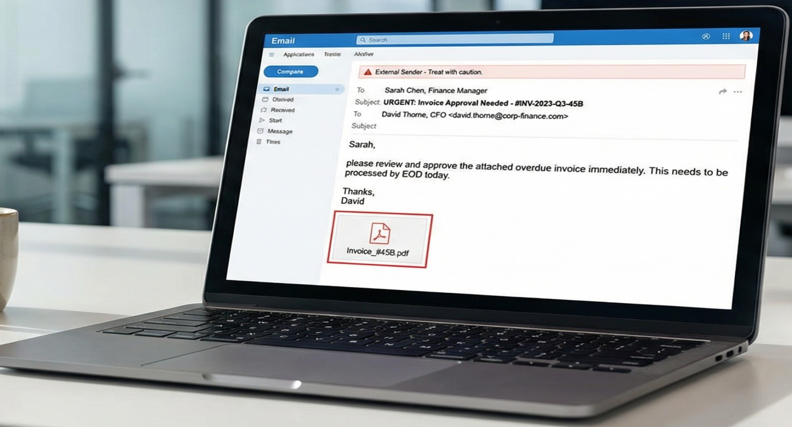
Types of Phishing
Spear Phishing Targeted attacks focused on specific individuals or roles
Spear Phishing
A targeted phishing attack aimed at a specific individual or role
Uses personal or job‑related information to appear legitimate
Often impersonates senior management, finance, or IT staff
Messages are customized, not sent in bulk
Designed to steal credentials, sensitive data, or money
Key Message: The more personal the email looks, the more dangerous it is.

Slide 9
Types of Phishing
Key Message
Phishing comes in many forms — not just email.

Slide 10
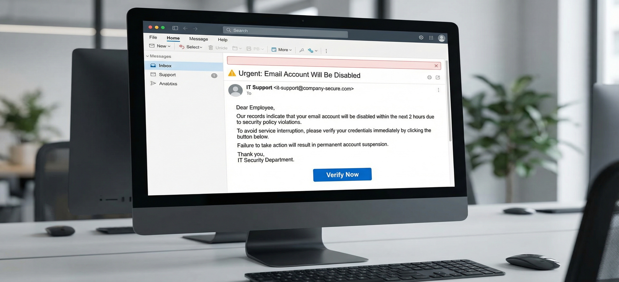
How a Phishing Attack Works Step 1: Email Received

Slide 11
How a Phishing Attack Works Step 2: Creating Urgency & Fear
See the content carefully of the Email:
From: IT Support <it-support@company-secure.com> Subject: ⚠ Urgent: Email Account Will Be Disabled
Dear User, Your email account will be disabled within 2 hours due to security issues. Please verify your account immediately.
Verify Now : https://company-secure.com/verify
➔ Keywords:
Account will be disabled
Immediate action required
Limited time
Link

Slide 12
How a Phishing Attack Works Step 3: Malicious Link Clicked
Verify Now : https://company-secure.com/verify
Step 4: Fake Login Page
Fake website copies the real login page design
Company logo and branding are imitated
Asks for email and password
Key Message: Looks real, but is fake
Step 5: Credentials Stolen
User enters login information
Information is sent to the attacker
Key Message: No system is hacked — the user provides the data

Slide 13
How a Phishing Attack Works
Step 6: Attacker Takes Control
Attacker accesses the email account
Sends phishing emails using the victim’s identity
Steals confidential company data
Changes the password and locks the user out
Key Takeaways
Phishing targets people, not systems
Urgency is a major warning sign
Always verify before clicking
Report suspicious emails immediately

Slide 14
Identification Signs of a Phishing Email
📌 Urgent or Threatening LanguageSign:
The email creates panic or urgency to force quick action.
Real-Life Example:“⚠ Your account will be suspended within 24 hours.Click the link immediately to avoid permanent closure.”
Why It’s Suspicious: Legitimate companies rarely pressure users with threats or deadlines.

Slide 15
Identification Signs of a Phishing Email
📌 Suspicious Sender Email AddressSign:
The sender’s email looks official but uses a fake or altered domain.
Real-Life Example: support@paypaI-secure.com (Uses capital “I” instead of lowercase “l”).
Why It’s Suspicious: Official PayPal emails come only from @paypal.com.

Slide 16
Identification Signs of a Phishing Email
📌 Generic GreetingSign:
The email does not use your real name.
Real-Life Example: “Dear Customer”, “Dear User”
Why It’s Suspicious: Legitimate organizations usually address you by your full name.

Slide 17
Identification Signs of a Phishing Email
📌 Suspicious LinksSign:
The link text looks normal but redirects to a fake website.
Real-Life Example:
Text shown: www.bank.com Actual link: http://bank-secure-login.net
Why It’s Suspicious: Phishing links often mimic real websites with small changes.

Slide 18
Identification Signs of a Phishing Email
📌 Requests for Sensitive InformationSign:
The email asks for passwords, OTPs, PINs, or card details.
Real-Life Example:“Please confirm your password and OTP to restore your account.”
Why It’s Suspicious: No legitimate company asks for sensitive information via email.

Slide 19
Identification Signs of a Phishing Email
📌 Spelling and Grammar Mistakes Sign
The email contains unusual spelling or grammatical errors.
Real-Life Example: “Your acount has been block. Verify immediatly.”
Why It’s Suspicious: Professional companies proofread their communications carefully.

Slide 20
Identification Signs of a Phishing Email
📌 Unexpected Attachments Sign
An attachment is sent without explanation or prior request.
Real-Life Example: Attachment: Invoice_48932.zip or PaymentDetails.exe
Why It’s Suspicious: Attachments may contain malware or ransomware.

Slide 21
Identification Signs of a Phishing Email
📌 Mismatched Branding or Design Sign
Logos, colors, or formatting do not match the official brand.
Real-Life Example: Gmail logo used in an email claiming to be from Microsoft. Such as ricrosoft.com
Why It’s Suspicious: Phishing emails often copy branding poorly.

Slide 22
Identification Signs of a Phishing Email
📌 Too Good to Be True Offers Sign:
Promises of free money, prizes, or rewards.
Real-Life Example:“🎉 Congratulations! You’ve won $1,000 from Google Lottery!”
Why It’s Suspicious: Legitimate companies do not give prizes randomly via email.

Slide 23
Identification Signs of a Phishing Email
📌 Call to Action Without Verification Sign
The email pushes you to click links or download files immediately.
Real-Life Example: “Click here to secure your account now.”
Why It’s Suspicious: Always verify through the official website instead of clicking links. 🛡 User Do’s and Don’ts in Case of Phishing Attacks

Slide 24
What to Do When You Receive a Suspicious Email
📌 What to Do
Stay calm and think before clicking or responding Read the email carefully Check the sender’s email address Hover over links to see the real URL.
Example: An email claims to be from your bank asking you to “verify your account.”
→ Check the sender domain and link before taking action.

Slide 25
What to Do When You Receive a Suspicious Email
📌 Do Not Click or Open
Do not click suspicious links Do not open unexpected attachments
Example: Email attachment: Invoice_2025.zip from an unknown sender
→ Do not download or open it.

Slide 26
What to Do When You Receive a Suspicious Email
📌 Verify Through Official Channels
Visit the official website directly (type the URL manually)
Contact customer support using known phone numbers or apps
Example: Instead of clicking an email link, open your bank app to check alerts.

Slide 27
What to Do When You Receive a Suspicious Email
📌 Never Share Sensitive Information
Do not share passwords. Do not share OTP, PIN, or card details. Do not reply with personal information.
Example: Email asks: “Send your OTP to secure your account”→ Legitimate companies never ask for OTPs via email.

Slide 28
What to Do When You Receive a Suspicious Email
📌 Report the Phishing Attempt
Report the email to IT/Security Team.
Use the “Report Phishing” option in your email client Inform your organization immediately.
Example: Forward the email to: security@company.com

Slide 29
What to Do When You Receive a Suspicious Email
📌 Delete After Reporting
Delete the email after reporting.
Empty the trash folder if required.
Reason: Prevents accidental clicks later.

Slide 30
What to Do When You Receive a Suspicious Email
📌 If You Clicked a Phishing Link (Immediate Actions)
Disconnect from the internet.
Example: Clicked a fake Microsoft login page → Reset password instantly.
Change your passwords immediately. Inform IT/Security team Run antivirus or endpoint security scan.

Slide 31
What to Do When You Receive a Suspicious Email
📌 Do Not Panic or Hide Mistakes
Do not panic.
Do not hide the incident. Do not delay reporting.
Why: Early reporting helps prevent bigger damage.

Slide 32
What to Do When You Receive a Suspicious Email
📌 Follow Security Best Practices
Enable Two-Factor Authentication (2FA).
Keep OS, browser, and apps updated.
Use strong and unique passwords

Slide 33
What to Do When You Receive a Suspicious Email
📌 Quick Summary –
Remember This ✅ Verify sender and links.
Report suspicious emails. Use official channels.❌Don’t click unknown links. Don’t share passwords or OTPs. Don’t trust urgent or prize messages.

Slide 34
🔐 Think Before You Click – Security Starts with You!”

